Slide 1
Life Cycle of Oil and Gas Fields in the Louisiana Coastal Zone
Impacts on the Mississippi Delta
John W. Day
Dept. of Oceanography and Coastal Sciences
Louisiana State University
Baton Rouge, LA

Slide 2
Outline
Overview of the Mississippi Delta
Pervasive alteration of surface hydrology and ecology
Induced subsidence and wetland loss
Pervasive contamination
Infrastructure left in place
Governmental and Societal Impacts

Slide 3
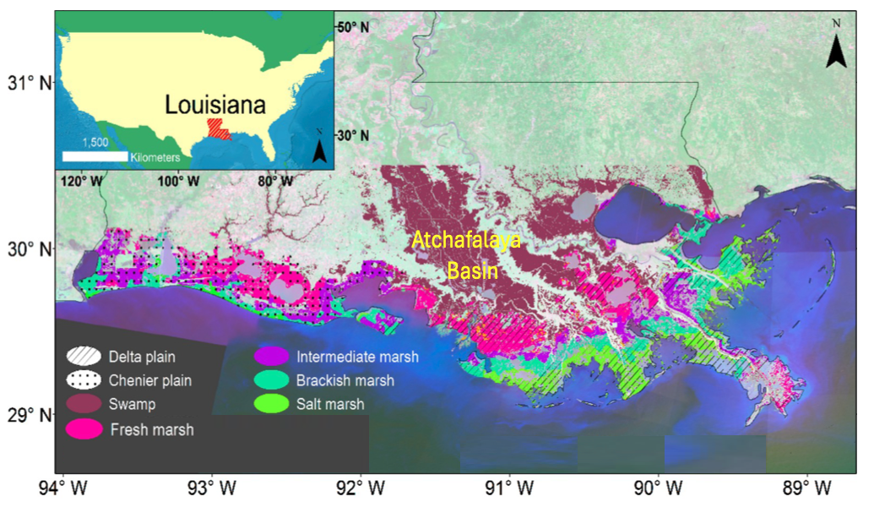
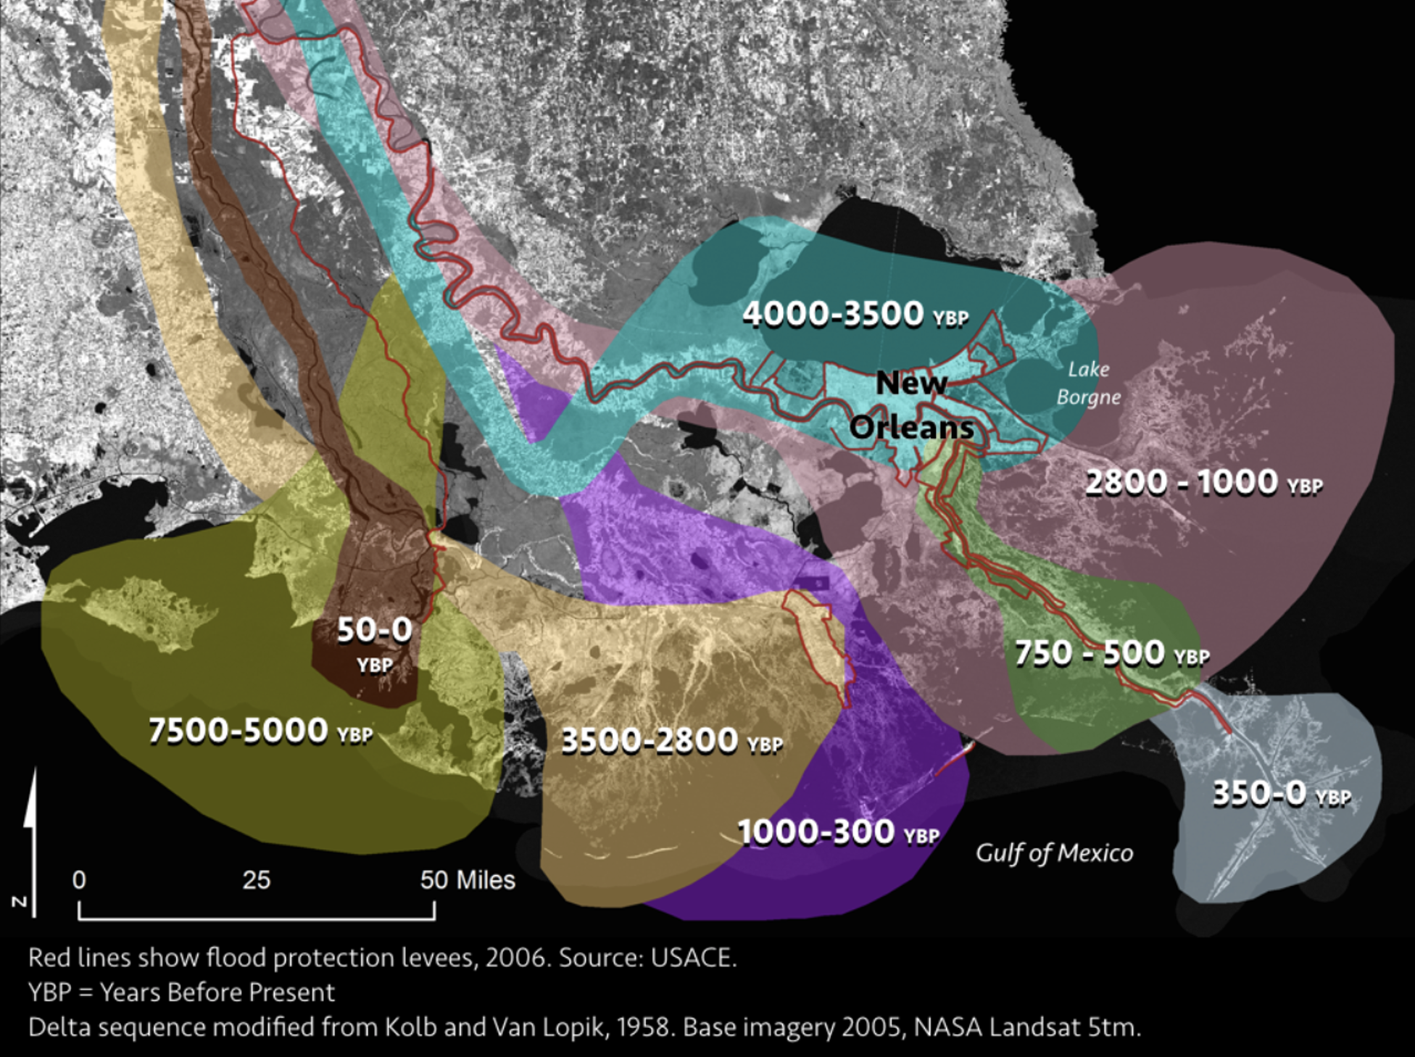
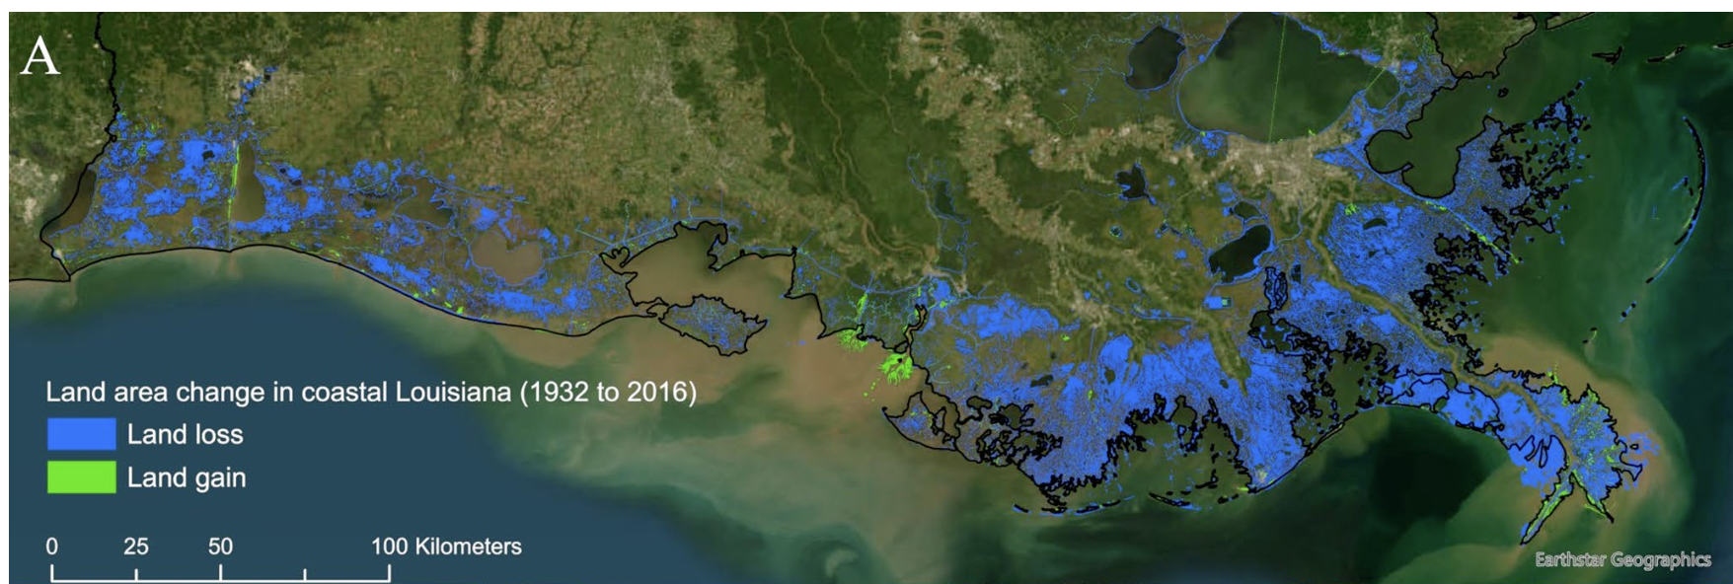
The Mississippi Delta
Delta
Lobes
Interdistributary Basins
and Vegetation Zones
Wetland Loss in the Mississippi Delta

Slide 4
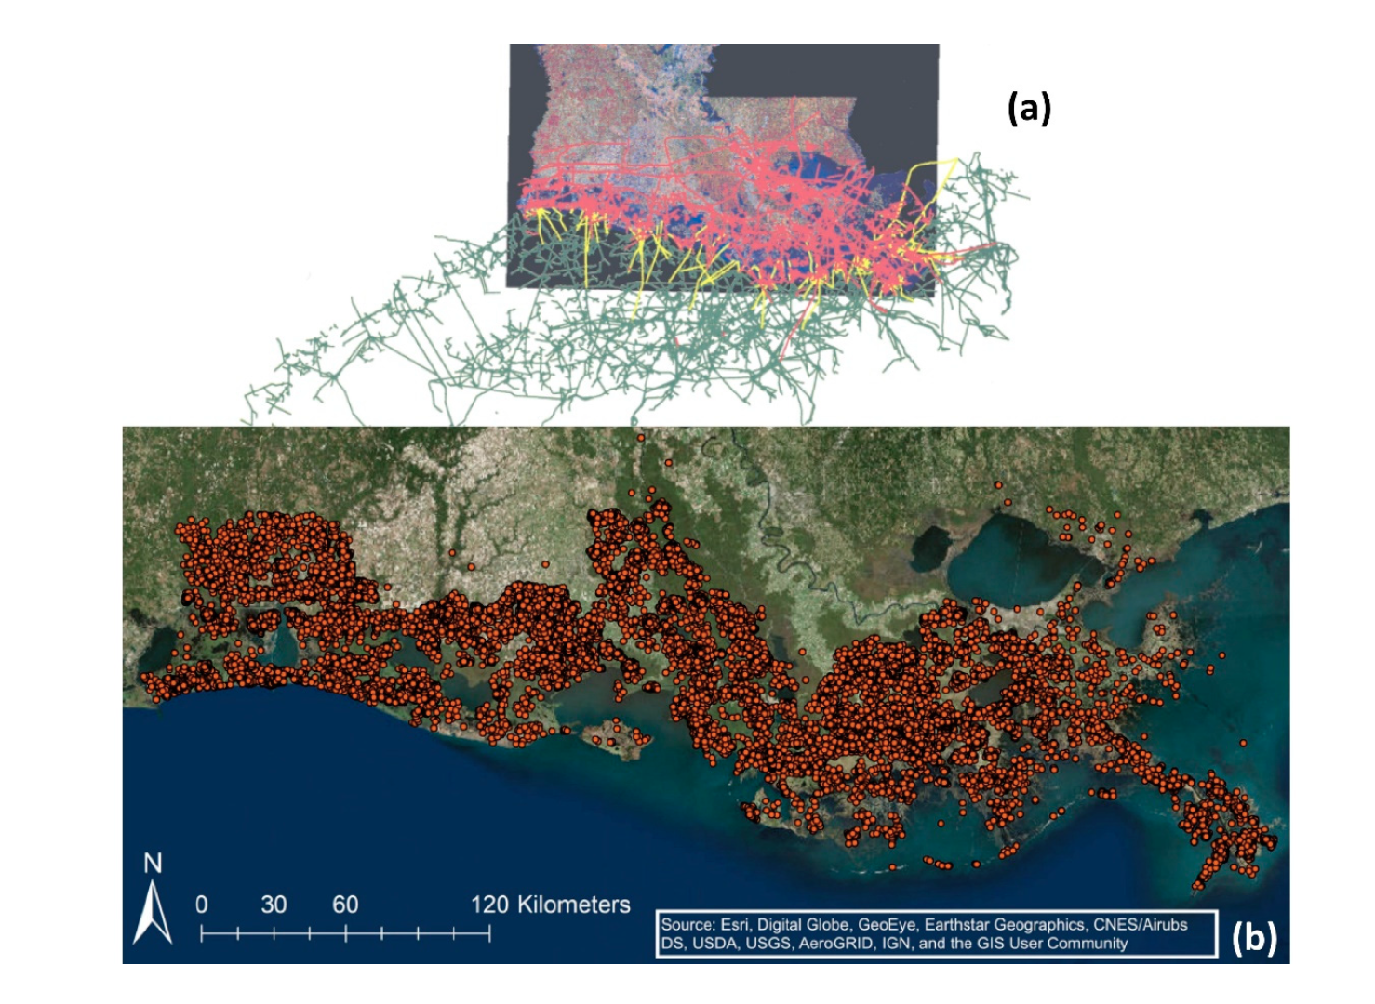
Oil and Gas Piplines
Oil and Gas Well Permits Issued Between 1900 and 2017 That Were Plugged or Abanonned as of 2017
Turner and McClenachan 2018

Slide 5
Morton et al. 2006
Production History and Wetland Loss

Slide 6
“Wagon Will” near Venice

Slide 7
Bully Camp
Sulfur
Production

Slide 8
ALTERATIONS TO SURFACE HYDROLOGY

Slide 9
Turner 1987

Slide 10
Adding Sediment Increases Productivity and Organic Soil Formation

Slide 12
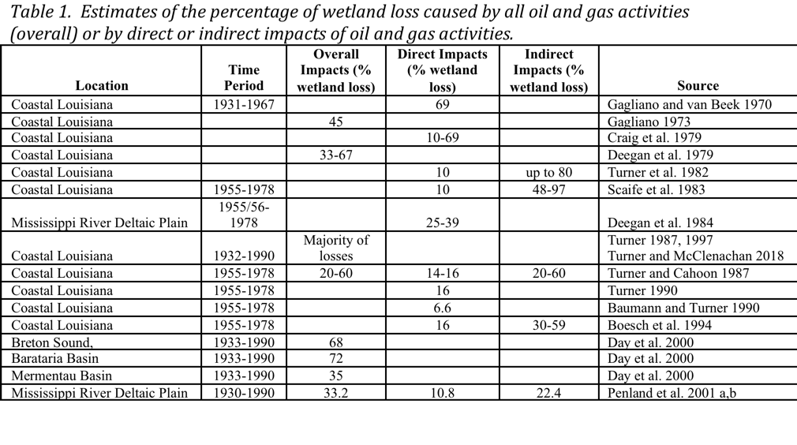

Slide 13
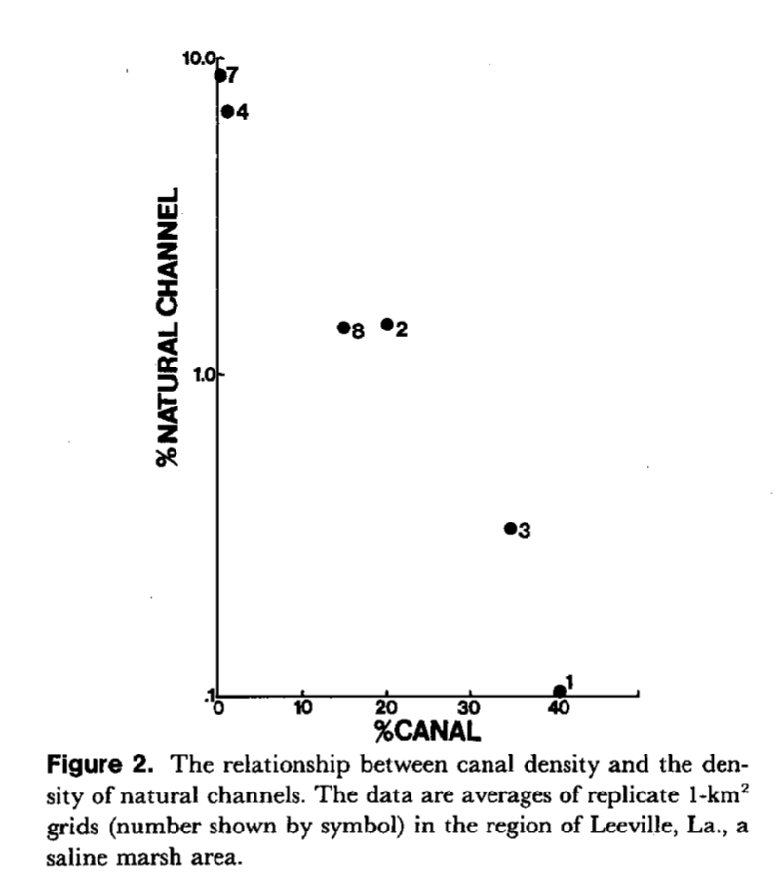
As Canal Density Increases, the Density of Natural Channels Decreases

Slide 14
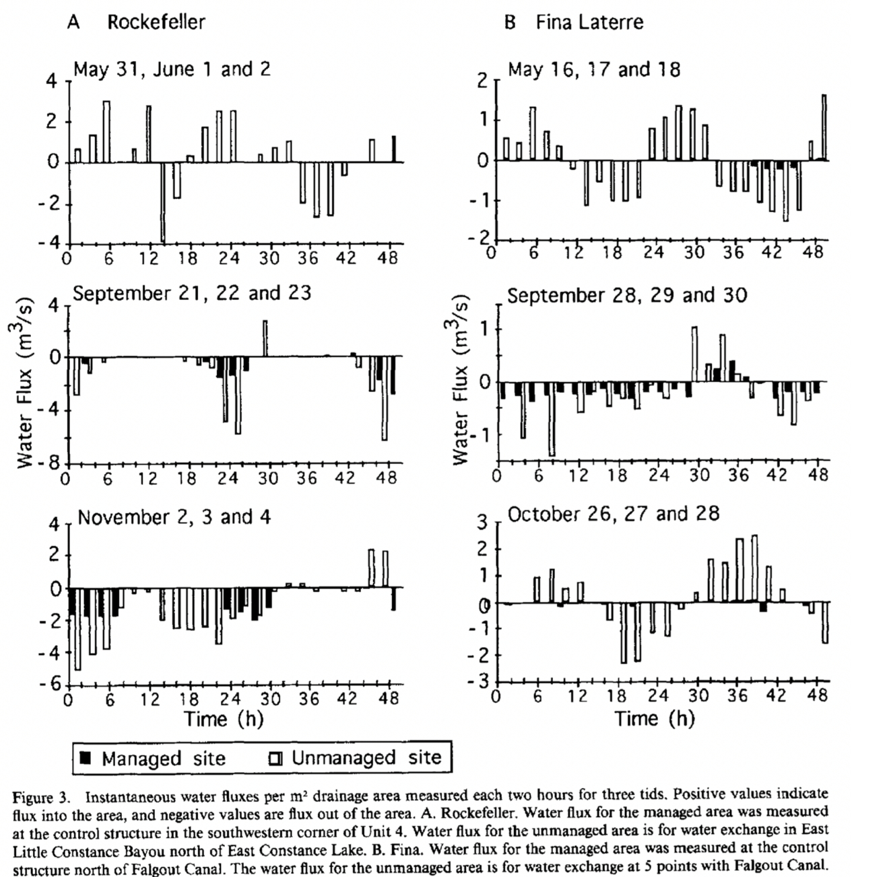
Water flux in Natural
and Impounded
Marshes

Slide 15
Paartially Impounded
Marshes Are Flooded
For Longer Periods
Of Time Than Natural
Marshes.
Total hours flooded, for one month, at a reference marsh with a natural berm and a partially-impounded area where about 75% of the natural berm had been replaced by a dredged canal spoil bank, Golden Meadow oil and gas field south of New Orleans, LA (Turner and Swenson 1987).

Slide 16
Rates of vertical accretion (left) and organic matter accumulation (right) in managed and
Unmanaged marshes at Fina LaTerre, LA (means and 1 SE; Cahoon 1994).

Slide 17
Deposition of Sediments
On the Marsh Surface Inside
And Outside of impoundments

Slide 18
Comparison of marsh surface sediment deposition rates between impounded and reference sites by management year (means ± 1 SE) and means for all years. Stars indicate statistically significant differences at p = 0.05. The horizontal line indicates the 1.1 g/m2/day of inorganic accumulation required for fresh marsh soils (Reed et al. 1997).

Slide 19
Widening of the Tennessee Natural Gas pipeline canals and formation of spoil flank ponds (CEI 2017).

Slide 20
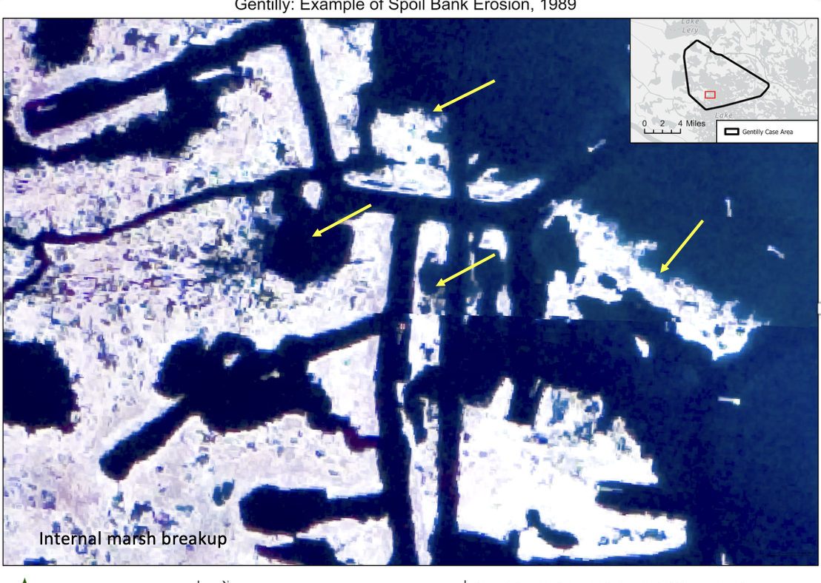
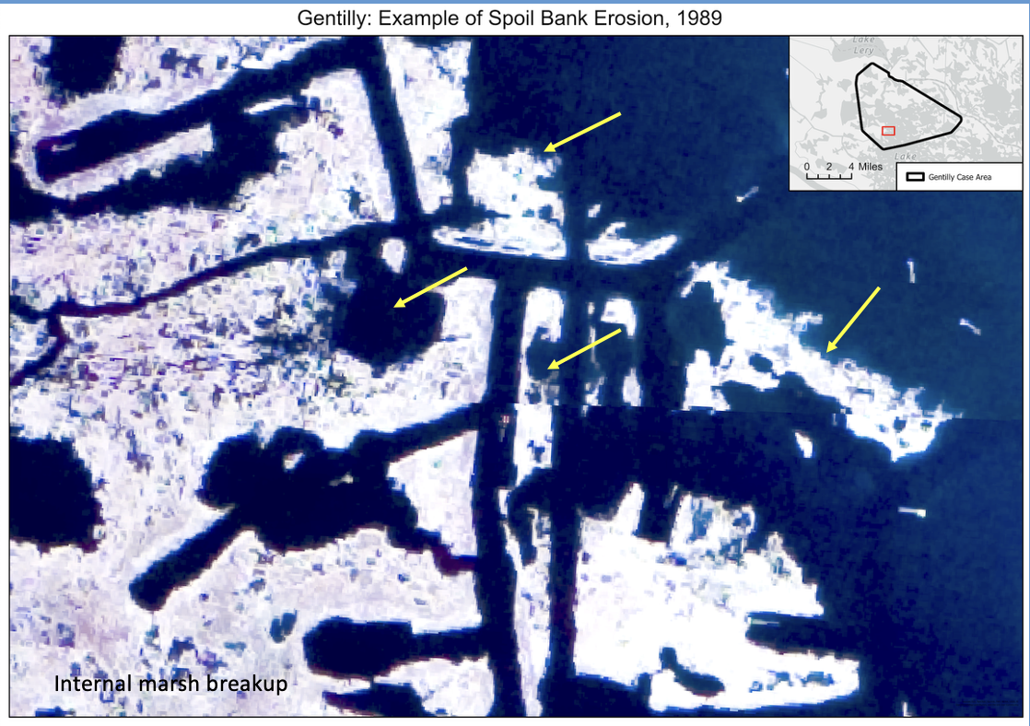
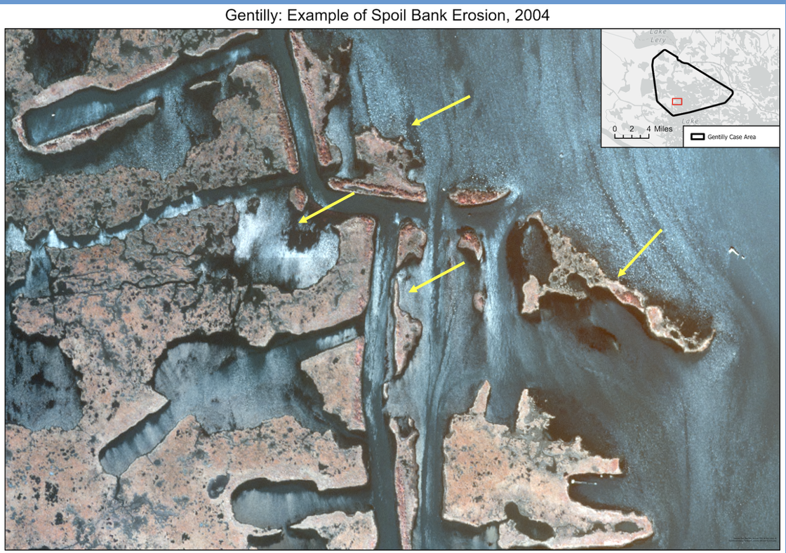
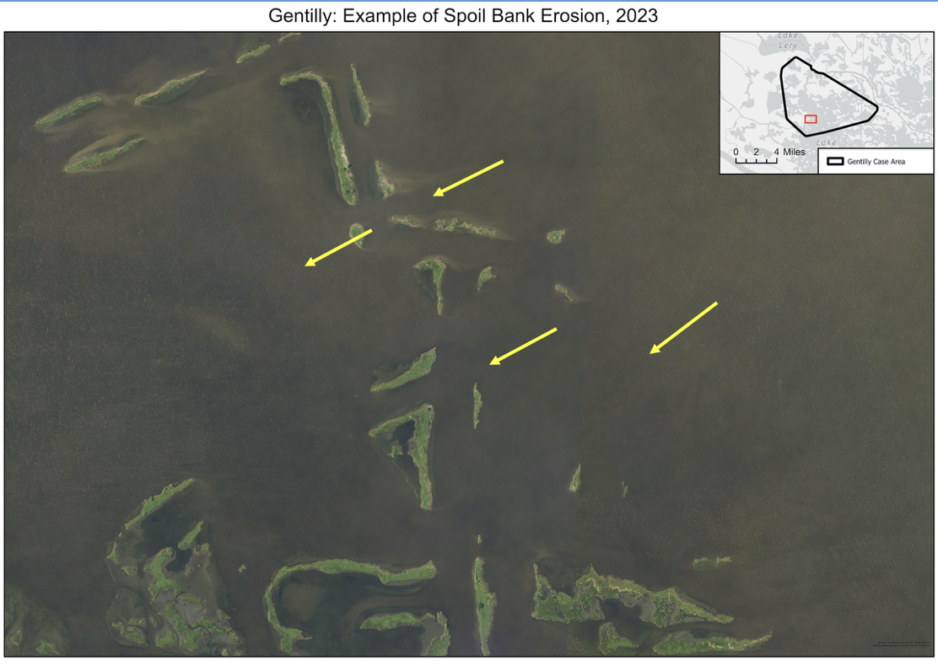

Slide 21
Relationship between canal width and age for the Southwest LA Canal, LaFourche
Parish, LA (Johnson and Gosselink 1982).

Slide 22
INDUCED SUBSIDENC
Reservoir Collapse due to oil and gas withdrawal
Secondary Collapse due to Slow Drainage of Water from Bounding Shales
Induced Subsidence due to Changes in Pressure Across Faults

Slide 23
Map showing average subsidence rates between 1965 and 1993 in south Louisiana.
Areas of highest subsidence rates (>12 mm/year; hatched pattern) correlate closely with locations of oil and gas fields.
Lowest average subsidence rates are located between major producing fields.

Slide 24
Plots of historical subsidence rates along LA Highway 1 between Raceland and Leeville, Louisiana showing a close spatial correlation between highest subsidence rates, hydrocarbon-producing fields (delineated in grey), and the projected intersection of the Golden Meadow fault zone (Morton et al. 2006).

Slide 25
Elevation changes during epoch 1 (1965-1982; A) and epoch 2 (1983-1993; B), and the rates of subsidence in the two epochs (C). Over the entire transect, subsidence rates were greater in epoch 2 than in epoch 1. The yellow squares in (A) and (B) indicate an arbitrarily selected reference station approximately 8 km south and outside of the projected Leeville field, to estimate the magnitudes of local production-related subsidence signals (Chang et al. 2014).
Slow drainage of pore fluids from shales
Fault activation
Reservoir compaction
Time dependent creep compaction
Acceleration after decrease of production

Slide 26
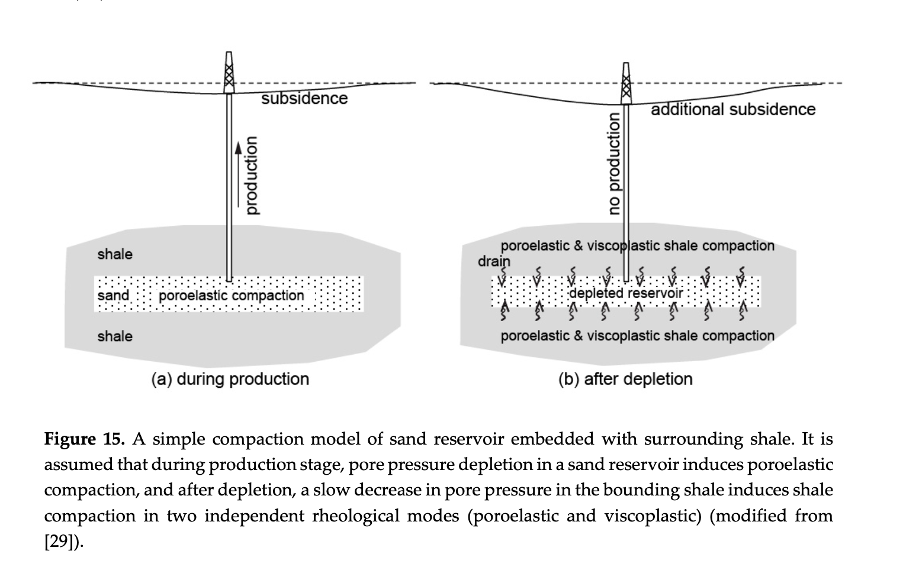

Slide 27
Sequence of production-related subsurface events that may induce land subsidence and reactivate faults. Prolonged or rapid production of oil, gas, and formation water (2) causes formation pressures to decline (3). This increases the effective vertical stress of the overburden (4), which causes compaction of the reservoir rocks and may cause formerly active faults (1) to be reactivated (5). Either compaction of the reservoir and surrounding strata or slip along fault planes can cause land-surface subsidence (6). Where compaction or fault-related subsidence occurs in wetland areas, the wetlands typically are submerged and converted to open water (7). Figure is not to scale (Morton et al. 2006).

Slide 28
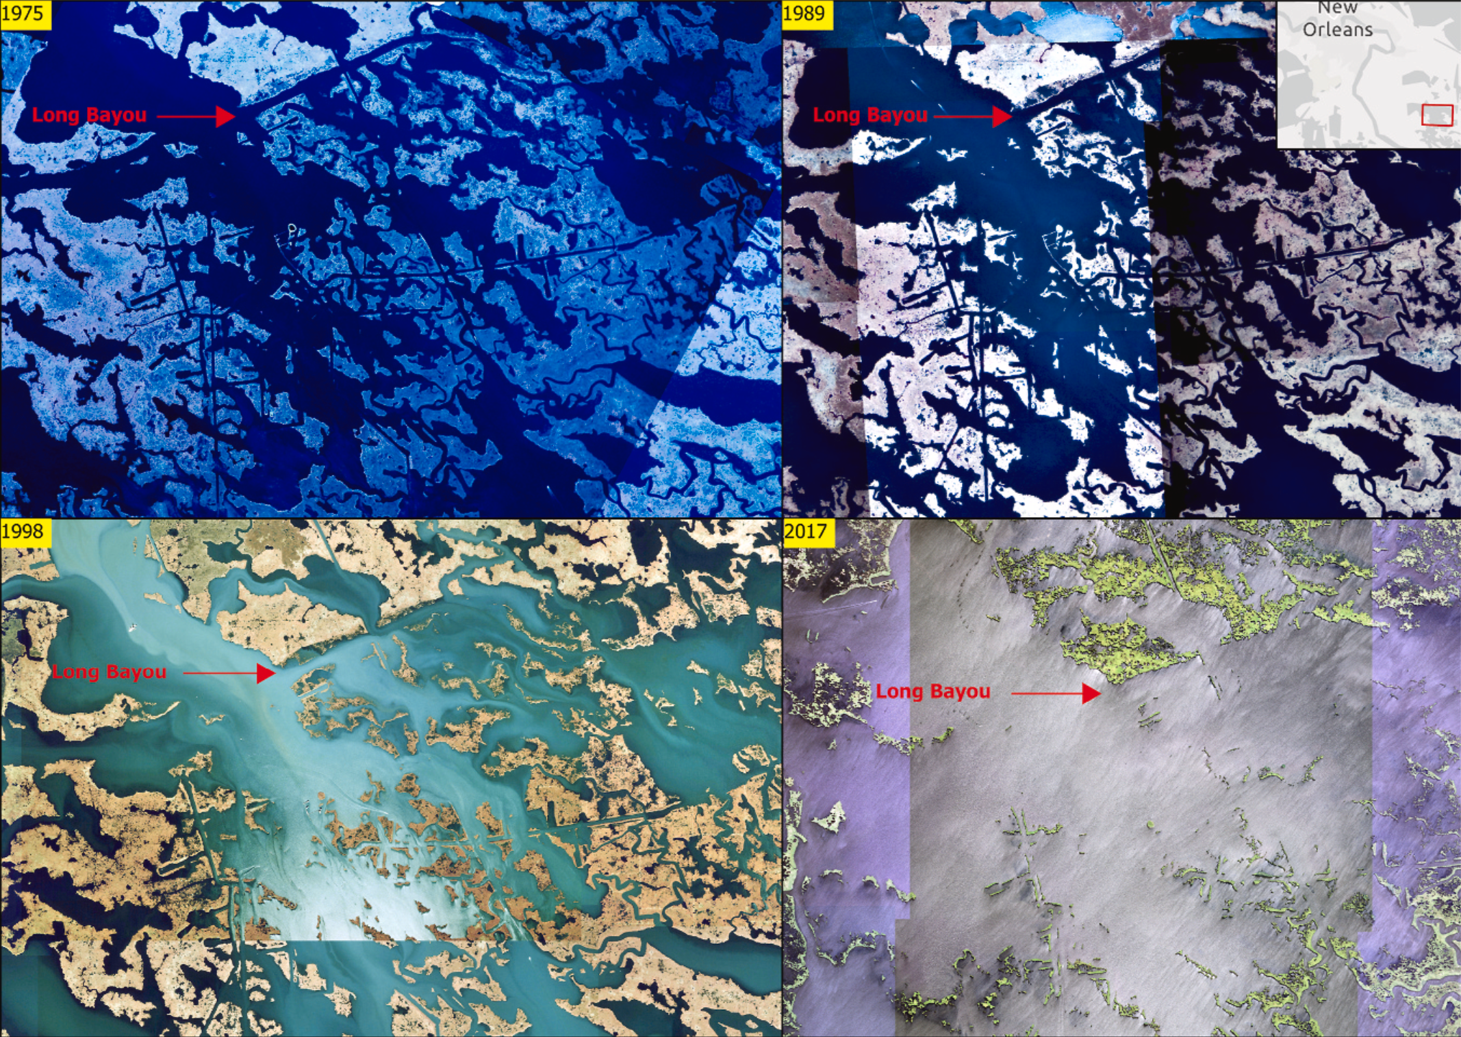
Breton Sound Basin (east of the Miss River). Wetland Loss mainly due to Petroleum impacts.
Canals and spoil banks altered surface hydrology, reduced sediment input to the marsh surface, and increased shallow subsidence.
Withdrawal of oil and gas increased deep subsidence due to fault activation (along Bayou Long), and reservoir collapse.
Wetlands north of Bayou Long have low loss rates because it is on the up thrown side of the fault with higher elevation. Wetlands on the down thrown side of the fault lost elevation.
Wetland Loss South of Bayou Long Mainly Due to Oil and Gas Activities.

Slide 29
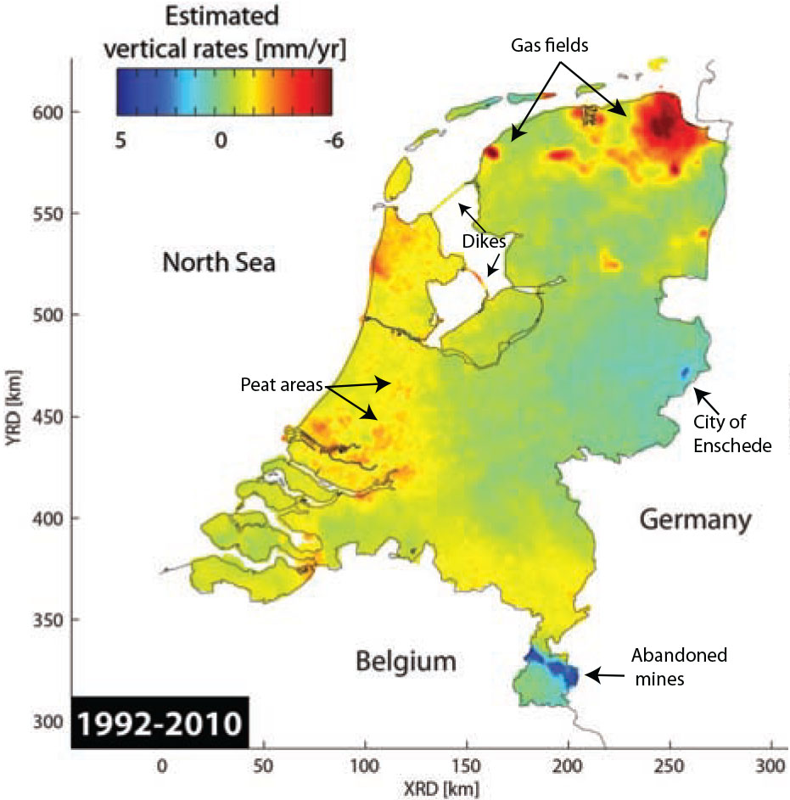
Caro Cuenca et al. (2011)

Slide 30
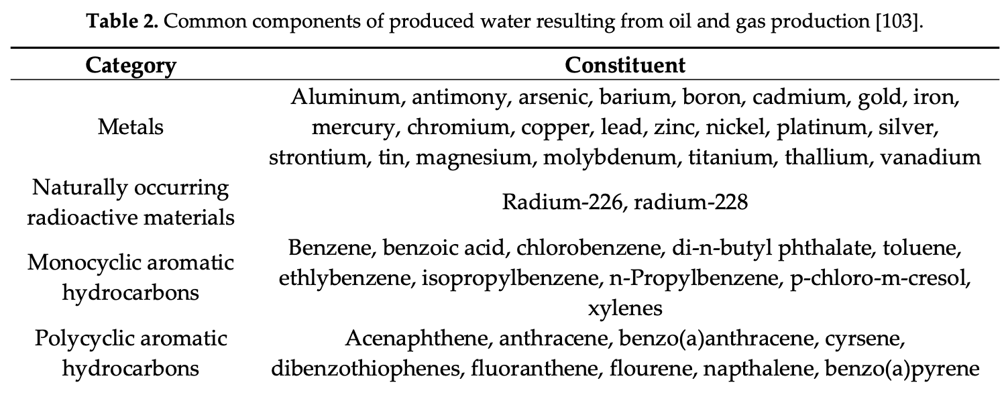
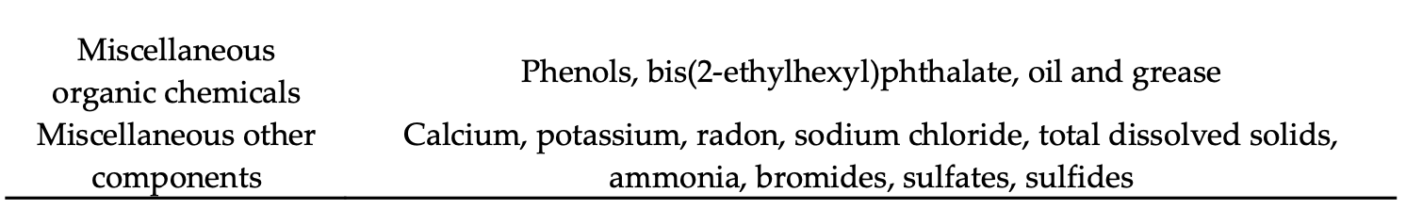
TOXICITY IMPACTS
There are high levels of toxins from produced water in sediments. Strong mixing events such as frontal passages and hurricanes can mix these toxins into the water column and advect them over marshes.
Produced Water is More Toxic Than Crude Oil

Slide 31
Not Used

